Slide 1
This lab was originally designed by students at MIT

Slide 2
Bioengineering: Banana smell generating device
E. coli with foul smell (HB101)
Delete the tnaA5 gene that produces indole (odor)
E. coli with less odor (YYC912)
Add the ATF1 gene
E. coli with ATF1
Add the precursor isoamyl alcohol
E. coli that smell like bananas

Slide 3
Banana smell generating device
ATF1
Isoamyl
alcohol
Isoamyl Acetate
(banana smell)
ATF1: encodes Alcohol acetyltransferase that converts isoamyl alcohol to isoamyl acetate. Derived from yeast.
Isoamyl alcohol: a precursor for the enzyme ATF1. Nearly odorless. Needs to be added to the culture to obtain banana smell.
Isoamyl acetate: the product of the reaction. This is the chemical that is naturally produces by bananas to produce their smell.

Slide 5
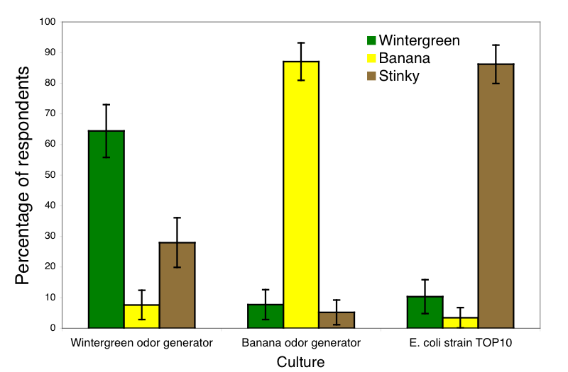
Notes:
Smell tests of cultures of wintergreen and banana odor generators
At the 2006 iGEM Jamboree, we conducted blind smell tests in which iGEM participants had to distinguish between cell cultures producing wintergreen odor, banana odor and the natural fecal odor of E. coli. Of the 116 respondents, 64% were able to correctly identify the culture producing methyl salicylate through its wintergreen bouquet, 87% were able to correctly identify the culture producing isoamyl acetate through its banana bouquet, and 86% were able to correctly identify the laboratory E. coli strain TOP10 through its stink. The error bars are the specific margin of error at 95% confidence. For the smell tests, we used the odor-free chassis (E. coli strain YYC912) for the wintergreen and banana odor generators.

